Slide 1


Slide 2

PROJECT TITLE : TAX EVASION DETECTION
BATCH NO : 6
DOMAIN : DATA SCIENCE
DATE : 15.05.2025
MENTOR NAME : MR.K.SEENI PULAVAR
DEPARTMENT : COMPUTER SCIENCE AND ENGINEERING
HEAD OF THE DEPARTMENT : DR.T.SHEIKYOUSUF
STUDENTS NAME :
REG No | NAMES
911521104007 | CHELLAPANDI M
911521104026 | MOHAMED KHALID A
911521104053 | THANUSH P

Slide 3
TITLE JUSTIFICATION
TAX EVASION DETECTION
The title "Tax Evasion Detection" clearly shows the main goal of the project – to find and stop people or companies who avoid paying taxes. This project uses machine learning and data analysis to detect unusual financial activities.

Slide 4
ABSTRACT
TAX EVASION DETECTION
Tax evasion detection is the process of identifying individuals or organizations that intentionally avoid paying taxes through fraudulent means. It combines advanced data analytics, machine learning, and financial forensics to examine patterns in transactions, tax filings, and business activities. This approach helps tax authorities detect unusual behaviors or discrepancies, ensuring fair tax practices and protecting government revenue. Techniques like predictive modeling, anomaly detection, and AI are commonly used to flag potential cases of tax evasion from large datasets.

Slide 5
INTRODUCTION
TAX EVASION DETECTION
Modern tax systems require smarter tools. This project uses advanced technologies to analyze large volumes of financial data in real-time, enabling quicker and more accurate detection of fraudulent activity. Compared to manual audits, these tech-driven methods are faster, scalable, and more effective.

Slide 6
OBJECTIVES
TAX EVASION DETECTION
Develop a smart and scalable system to detect tax evasion.
Use machine learning and pattern recognition for early detection.
Improve compliance and revenue collection.
Support resource optimization for tax enforcement.

Slide 7
EXISTING SYSTEM
TAX EVASION DETECTION
Manual and rule-based systems.
Slow and resource-intensive.
Limited ability to detect complex fraud.
Reliance on historical patterns; lacks real-time capability.
Resource : Big Data Applied to Tax Evasion Detection:” by Paulo Cesar Abrantes and Felipe Ferraz, published by IEEE at the 2016 International Conference on Computational Science and Computational Intelligence (CSCI), Las Vegas, USA.

Slide 8
DISADVANTAGES OF EXISTING SYSTEM
TAX EVASION DETECTION
Inconsistent data quality and availability.
High false positives/negatives.
Algorithm bias.
High computational load.
Interpretability and adaptability challenges.
Ethical and regulatory concerns.

Slide 9
PROJECT SCOPE
TAX EVASION DETECTION
Analyze financial data (returns, transactions, 3rd-party records).
Use ML algorithms to detect anomalies.
Provide insights to enhance auditing and decision-making.
Support real-time monitoring and integration with tax systems.

Slide 10
ALGORITHMS USED
TAX EVASION DETECTION
Random Forest – Ensemble method for classifying tax risk.
Logistic Regression – Binary classifier to flag suspicious returns.
Support Vector Machine (SVM) – Identifies fraud boundaries using data points.

Slide 11
PROPOSED SYSTEM
TAX EVASION DETECTION
The proposed system enhances tax evasion detection by using machine learning, AI, and big data analytics. Unlike traditional rule-based methods, it applies predictive models and anomaly detection to analyze large-scale financial data in real time. By integrating diverse sources like tax returns, transactions, and third-party records, the system can accurately identify suspicious patterns and flag potential evasion cases with greater speed and precision.

Slide 12
ADVANTAGES
TAX EVASION DETECTION
Accurate fraud detection.
Real-time alert generation.
Reduces manual workload.
Adaptable to multiple tax jurisdictions.
Learns and evolves with fraud trends.
Helps prioritize high-risk cases.

Slide 13
START
FLOWCHART –DF –LEVEL-3
TAX EVASION
DATASET
DATA CLEANING
& NORMALIZATION
DATA PARTITIONING
(TRAIN AND TEST)
YES
MODEL TRAINING
(DL ALGORITHM ON TRAIN DATA )
Random Forest Algorithm
Decision Tree Algorithm
Linear Regression Algorithm
Hybrid Random Forest and Decision Tree Algorithm
NO
TAX EVASION
DETECTION &
METICES ANALYSER
END

Slide 14
MODULES
TAX EVASION DETECTION
Data Insight Gatherer and Refiner
Data Preprocessing(Train and Test)
Data splitting
Model Training
Prediction
Performance Analyzer

Slide 15
IMPLEMENTATION TECHNIQUES
TAX EVASION DETECTION
Data Collection
Gather financial transaction data, tax filings, and third-party records.
Data Preprocessing
Clean and normalize data to remove errors and inconsistencies.
Split the dataset into training and testing sets.
Feature Selection
Select important attributes (e.g., income, transaction type, risk score) that help in detecting tax evasion.

Slide 16
IMPLEMENTATION TECHNIQUES
TAX EVASION DETECTION
Machine Learning Algorithms
Random Forest: Detects suspicious patterns using multiple decision trees.
Decision Tree: Simple and interpretable model for classifying data.
Logistic Regression: Classifies tax returns as normal or suspicious.
SVM: Separates evasion and non-evasion cases using boundaries in the data.
Model Training
Train models using the training dataset to learn patterns of tax evasion.
Model Testing & Evaluation
Test the models with unseen data and evaluate using metrics like accuracy, precision, and recall.

Slide 17
IMPLEMENTATION TECHNIQUES
TAX EVASION DETECTION
Prediction & Classification
Use trained models to predict if a new transaction is legal or illegal.
Visualization & Reporting
Show results and patterns using graphs and dashboards.
Generate automated reports for better decision-making.

Slide 18
SYSTEM REQUIREMENT
TAX EVASION DETECTION
Software:
OS: Windows 10/11
Language: Python
IDE: Anaconda Navigator (Spyder)
Frontend: Flask
Hardware:
Processor: Pentium IV or higher
RAM: 4 GB
Storage: 200 GB

Slide 19

OUTPUT SCREENSHOTS
Fig:1 – Home

Slide 20
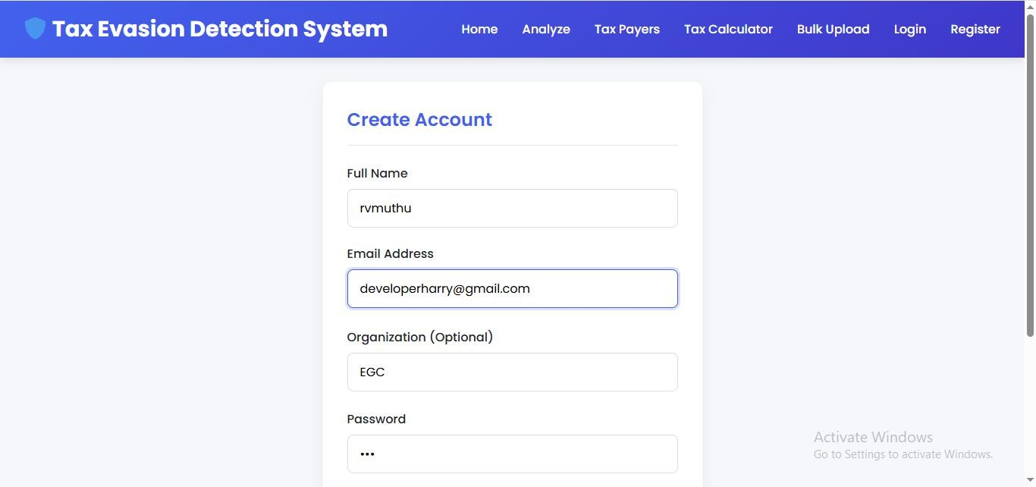
OUTPUT SCREENSHOTS
Fig:2 – Register Account

Slide 21
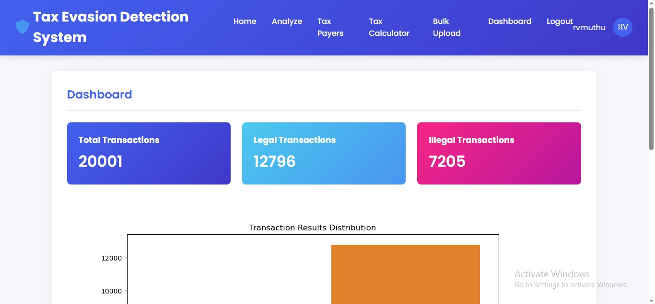
OUTPUT SCREENSHOTS
Fig:3 – Dashboard

Slide 22
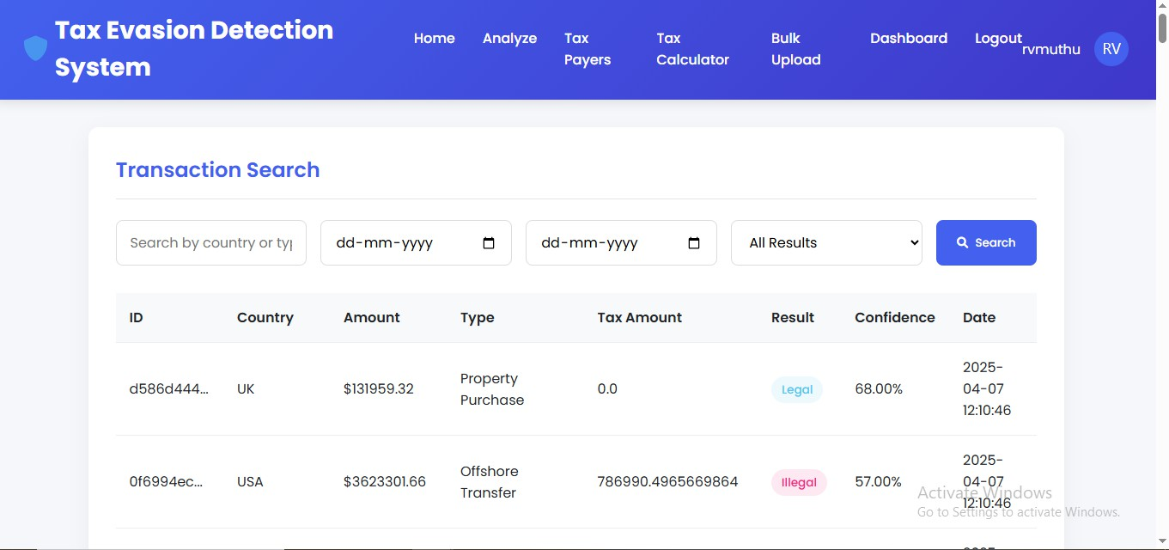
OUTPUT SCREENSHOTS
Fig:4 – Result Details

Slide 23
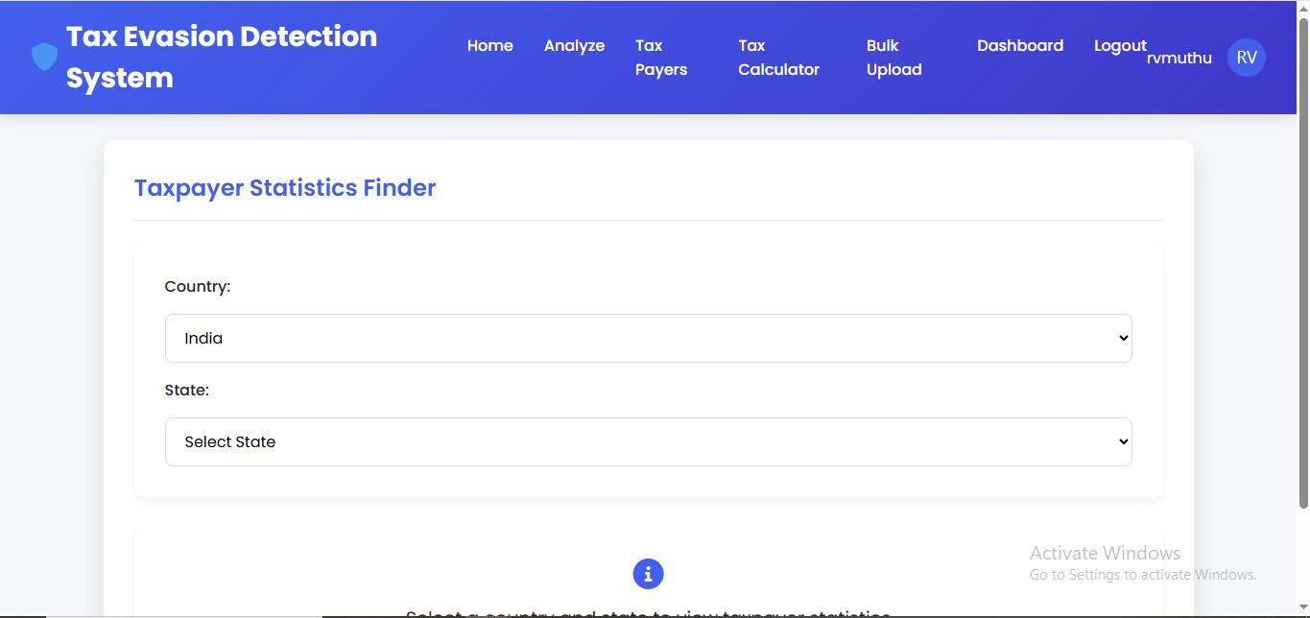
OUTPUT SCREENSHOTS
Fig:5 – Tax Payers Finder

Slide 24
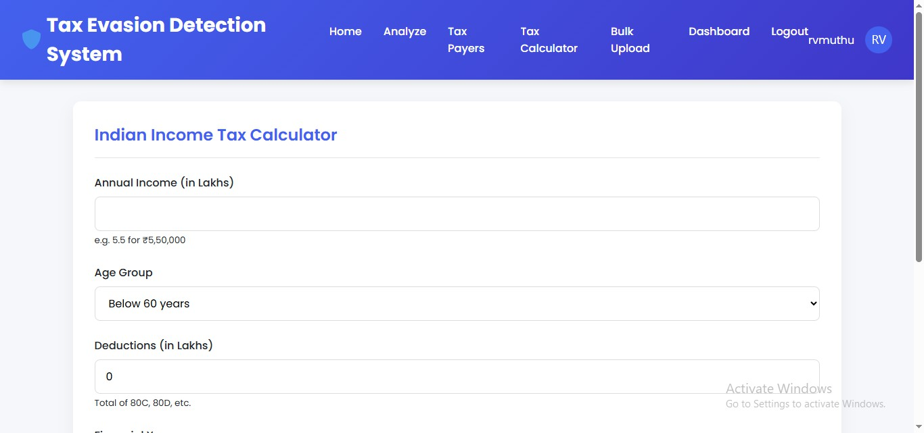
OUTPUT SCREENSHOTS
Fig:6 – Income Tax Calculator

Slide 25
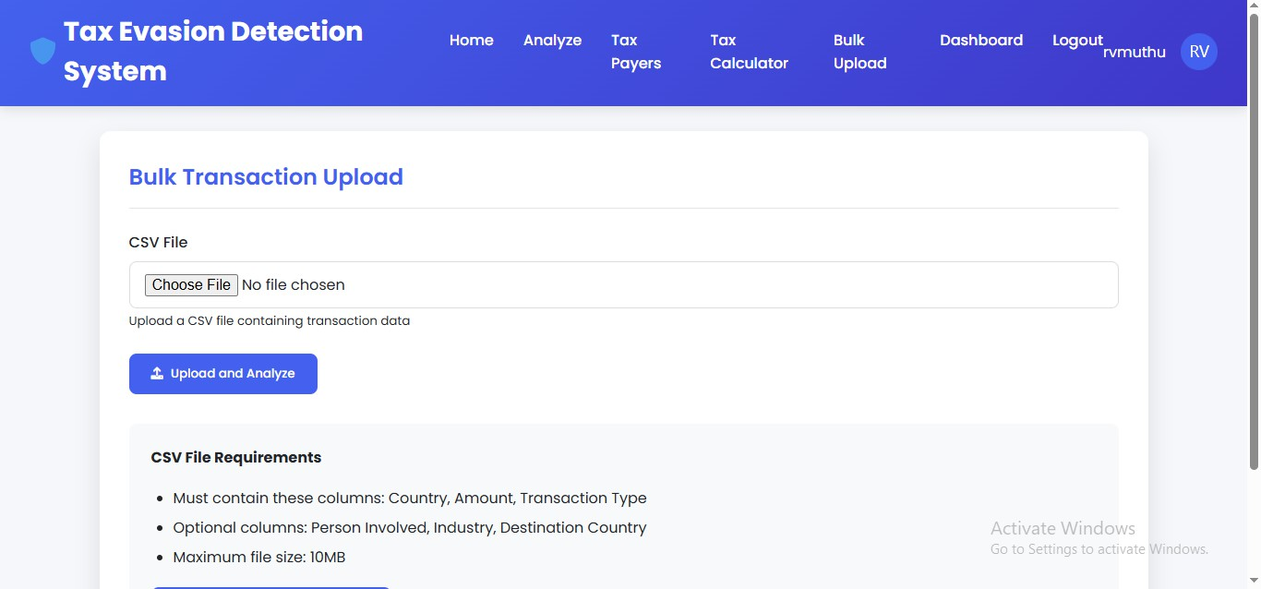
OUTPUT SCREENSHOTS
Fig:7 – Upload File for Statements

Slide 26
CONCLUSION
TAX EVASION DETECTION
The Tax Evasion Detection system successfully demonstrates the use of machine learning and data analytics to identify fraudulent tax behavior. By analyzing large volumes of financial data and recognizing hidden patterns, the system improves the accuracy and efficiency of detecting tax evasion compared to traditional methods.
This approach reduces manual auditing efforts, saves time, and helps tax authorities focus on high-risk cases. With real-time analysis and intelligent classification, the system supports better decision-making and enhances overall tax compliance. It is also scalable and adaptable to different tax jurisdictions, making it a valuable tool in modern tax administration.

Slide 27
FUTURE ENHANCEMENTS
TAX EVASION DETECTION
Real-time analytics
Integration with broader data sources
Smarter AI models
Dynamic threshold scoring
Visual dashboards and reports
Advanced anomaly detection techniques

Slide 28
REFERENCES
TAX EVASION DETECTION
Alon-Barkat, S. (2019). Can AI and Machine Learning Improve the Detection of Tax Evasion? Journal of Financial Crime, 26(2), 410–429.
Chen, L., & Zhao, M. (2020). Deep Learning Approaches to Tax Evasion Detection. Proc. of the Int. Conf. on Machine Learning and Data Mining, 450–463.
Fan, X., & Liu, W. (2019). A Survey on Machine Learning in Tax Evasion Detection. Artificial Intelligence Review, 52(1), 311–327.
Fischer, L., & Klan, R. (2021). Innovations in Financial Crime Detection: Harnessing Machine Learning for Tax Evasion. Journal of Financial Technology, 7(2), 47–65.

Slide 29


Thank You!
“Detecting fraud isn't just about technology — it's about protecting fairness, trust, and the future.”

